Slide 1
Navigating the Evolving Trade & Tariff Environment
FEI Colorado Strategic Partner Breakfast

Slide 2




Presenters
Ben Cote
  Partner
    Tax
Biz Pavelich
  Senior Manager
  Transfer Pricing
Megan Rudolph
  Manager
  International Tax
Steve Schnepel
  Partner
  International Tax
Notes:
BEN

Slide 3
Agenda
Understanding Tariffs
Tariff Impact Assessment
Tariff Mitigation and Transfer Pricing
Other Mitigation Strategies
North American Nearshoring
Client Examples
One Big Beautiful Bill
Notes:
BEN

Slide 4
Understanding Tariffs

Slide 5
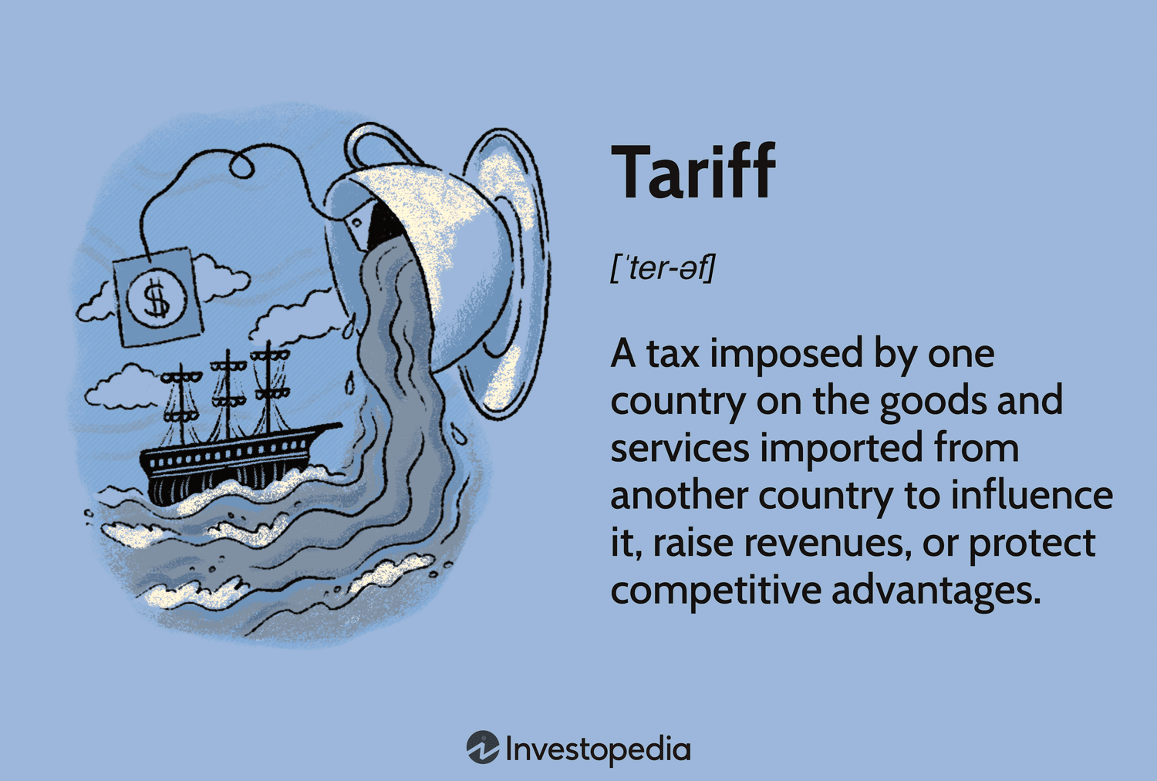
Understanding Tariffs: What is a Tariff?
A tariff is a tax imposed on goods and services as they move across international boundaries.
The most prevalent form is an import tariff, which is imposed on tangible goods entering a country.
The importer of record is usually responsible for paying the tariffs.
Notes:
MEGAN
Tariffs are generally applied for either protection or revenue generation. A protective tariff raises the cost of imported goods compared to domestic products, prompting consumers to prefer local goods and thereby shielding local producers from international competition. On the other hand, a revenue tariff is primarily designed to raise funds for the government.
The responsibility for paying import tariffs typically falls on the importer. As a result, importers often transfer some or all of these additional costs to consumers. This means that the final price of imported goods may be higher, reflecting the tariff expenses incurred during the import process.
Tariffs: What are they, who pays for them and who do they benefit?
What are tariffs? Here's everything you need to know about the import duties. - CBS News

Slide 6

Understanding Tariffs: Common Myths
Tariffs are a Form of Sales Tax: Unlike sales taxes, which are transparent and itemized on receipts, tariffs are applied when goods enter a country and are not separately listed. This can make it seem like tariffs are hidden costs.
Intercompany Operations or Imports Are Exempt from Tariffs: Some believe trade between related parties or intercompany imports is exempt from tariffs. However, every cross-border operation is subject to tariffs, regardless of the relationship between the parties involved.
Impact of the Tariff falls on the Foreign Exporter: Many people believe that foreign exporters bear the cost of tariffs. When in reality, the burden often falls on domestic importers, who may pass these costs onto consumers.
Tariffs Only Affect Final Products: It’s a common misconception that tariffs only affect finished goods. Tariffs can also be imposed on raw materials and intermediate goods, increasing manufacturers' production costs.
Notes:
MEGAN

Slide 7
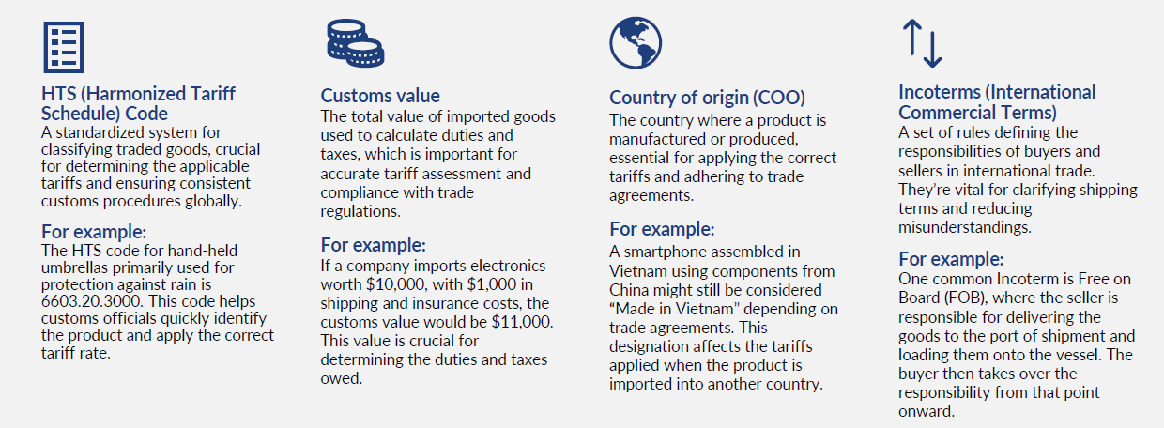
Key Elements of Tariffs
Notes:
STEVE

Slide 8
Tariff Impact Assessment

Slide 9
Tariff Impact Assessment
Assessing financial exposure and determining how tariffs impact your cost of goods is a complex analysis that requires a data-driven approach and input from cross-functional stakeholders. Key activities to performing the assessment include:
1
2
3
4
Compile data & documentation
Validate bill of materials
Confirm country of origin
Verify HTS classifications
5
6
7
8
Review trade agreements
Calculate exposure
Document compliance
Monitor changes
Notes:
STEVE

Slide 10

Benefits of Tariff Impact Assessment
Understand where you have the most significant financial exposure to tariffs.
Use assessment results to prioritize and focus mitigation efforts that will drive the greatest financial impact.
Potentially use documented impact in future customer recovery discussions and negotiations.
Notes:
STEVE

Slide 11
Tariff Mitigation and Transfer Pricing

Slide 12
Transfer Pricing
Transfer pricing refers to how related entities price transactions between each other:
Tangible goods/materials
A and B are related parties in different tax jurisdictions.
Differences between jurisdictional tax rules and rates create strategic planning opportunities for MNEs to manage global cash flow and effective tax rates.
Intangible assets
A
B
Services
Leases, loans, guarantees

Slide 13
Tariff Mitigation and Transfer Pricing
Importance of transfer pricing:
Increased IRS focus on transfer pricing
Reciprocal tariffs expected to impact related party transactions
Action items:
Review and realign supply chain
Revisit transfer pricing policies and characterization of entities
Evaluate intercompany agreements
Support intercompany pricing with robust comparables’ analyses
Tariffs influence transfer pricing decisions by affecting the profitability of related party transactions

Slide 14
Tariff Mitigation and Transfer Pricing
Supply chain review: Is the supply chain flexible enough to move more functions, assets, and risks to the United States?
Transfer pricing aligns profit with the functions, assets, and risks of an entity. Tariffs are ​
based on import price. If more activity is taking place after import of the good, then the ​
cross-border intercompany price can be reduced, which means the tariff applies to a ​
lower value.
Clear characterization of entity roles: What risks does each entity bear?
Many multinationals have U.S. distributors that operate as limited risk, for example. ​
Entities that are limited risk may initially incur the cost of the tariffs, but these costs may ​
ultimately be borne by a non-U.S.-related entity. Evaluating the specific characterization of ​
each entity will help to inform where the costs should ultimately reside.

Slide 15
Tariff Mitigation and Transfer Pricing
Intercompany agreements: Are the transfer pricing policies formalized?
Accurate intercompany agreements are important for all intercompany transactions. ​
Now more than ever, it’s critical that the intercompany agreements reflect the ​
current state of the cross-border transactions to support changes in the internal ​
supply chain or to crystallize the entity roles within the overall group.
Comparables’ analysis: How up to date are the comparables?
Setting transfer pricing relies on the most recently available market observations. ​
Often, this means reviewing annual financial data of public companies. To capture data ​
that reflects the impact of tariffs on the comparable companies, more active monitoring ​
may be necessary and review of quarterly data may provide better guidance.

Slide 16
Example
A U.S.-based automotive distribution company imports finished goods from a related party in Mexico.
Tariffs increase the cost of these finished goods, impacting profitability.
Shift assembly to the United States: Move the final assembly of parts to a U.S. facility.
U.S. distributor
Mexico Co.
Finished goods
U.S. Co.
Finished goods
Third-party
North American customer
 | Before tariff | After tariff
 | Distributor | Distributor | Value-add assembler/ distributor
Sales | 100 | 100 | 100
COGS | 70 | 70 | 40
Tariff (20%) | - | 14 | 8
Gross profit | 30 | 16 | 52
OPEX | 20 | 20 | 50
Operating profit | 10 | (4) | 2
U.S. value-added assembler and distributor
Mexico Co.
Semi-finished
goods
U.S. Co.
Finished goods
Third-party
North American customer
Notes:
Benefits:
Reduced Tariff Impact: By assembling parts in the US, the company can import components rather than finished goods, which may be subject to lower tariffs.
Lower Intercompany Pricing: The intercompany price of the components is lower than the finished goods, reducing the overall cost.
Enhanced Compliance: Aligns with IRS and customs regulations, reducing the risk of scrutiny.
documentation is key in transfer pricing
Whatever changes you make, or implement, make sure you are supporting within the TP regulations
Document your due diligence and analyses appropriately and contemporaneously

Slide 17
Other Mitigation Strategies

Slide 18
Other Mitigation Strategies
Manufacturers can leverage several additional strategies to mitigate tariff impacts based on specific needs, product and manufacturing considerations, and priorities, including:
HTS reclassification
Tariff engineering
Make vs. buy
Alterative sourcing
Reshoring and production transfer
Notes:
HTS reclassification:
We help clients accurately classify their imported goods under the Harmonized Tariff Schedule (HTS) codes. Imports can often qualify for a more favorable tariff treatment, resulting in significant cost savings without physically altering the product.
Tariff engineering:
To reduce or eliminate tariff impact, we provide guidance on strategies to reimagine product design (functional adjustments, use of alternative materials, etc.) or manufacturing processes (e.g., shipping unassembled components versus finished goods).
Make vs. buy
We can assess whether it's more cost-effective to manufacture products in-house (make) or source them from external suppliers (buy), particularly when tariffs are a significant consideration.
Alternative sourcing
We can identify and evaluate cost-effective alternative sources, to reduce reliance on suppliers in countries where the U.S. has imposed substantial import duties. We can help you explore new suppliers, production locations, and materials, while maintaining product quality and reducing or maintaining overall costs
Reshoring
Our team can evaluate the feasibility of reshoring manufacturing to the U.S. — which could offer long-term, strategic tariff reduction for companies facing a significant duty increase on imported goods. We perform detailed cost-benefit analyses, assess infrastructure and workforce availability, and identify government incentives.

Slide 19
Client Examples

Slide 20
One Big Beautiful Bill

Slide 21
U.S. Tax Update
One Big Beautiful Bill
    §174 R&E
    Bonus Depreciation
    SALT Cap
    QBID
    §899 Unfair Foreign Tax Rule
Notes:
BEN

Slide 22
Q&A

Slide 23




Contact your presenters
Ben Cote
  Partner | Tax
    Ben.Cote@plantemoran.com
Biz Pavelich
  Senior Manager | Transfer Pricing
    Biz.Pavelich@plantemoran.com
Megan Rudolph
  Manager | International Tax Services
    Megan.Rudolph@plantemoran.com
Steve Schnepel
  Partner | International Tax Services
    Steve.Schnepel@plantemoran.com

