Slide 1
Clear Out the Noise – Achieve Your Goals
Financial Executives International
Denver, Colorado
June 19, 2025
Ken Rutherford

Slide 2
CLEAR OUT THE NOISE
Faith – Whether you call it one thing, or your faith refers to it as a another, that voice is there. For me, My faith.
I found the existence of death as actually invigorating. Helps us treat our time as a gift.
Rocket Fule: Engergizing and propelling.
As I was dying, I started to live (In some ways antithetical)
QUESTION: IF THE NOISE IN YOUR LIFE WERE CLEARED, WHAT WOULD YOU HEAR?

Slide 3
Finding Strength To Accomplish Your Goals
Clarity is power. Clarity kills doubt. Once the noise is cleared, follow your goal and make it your priority. With unprecedented ruthlessness and single-mindedness.
“I was making B’s in five things. I want to make A’s in three things.’
Mathew McConaughy when he shut down his production company and music label business.
“Clarity is freedom. Knowing what is important to you and it will grant you the freedom to ignore everything else.”
– James Clear. [Atomic Habits].

Slide 4

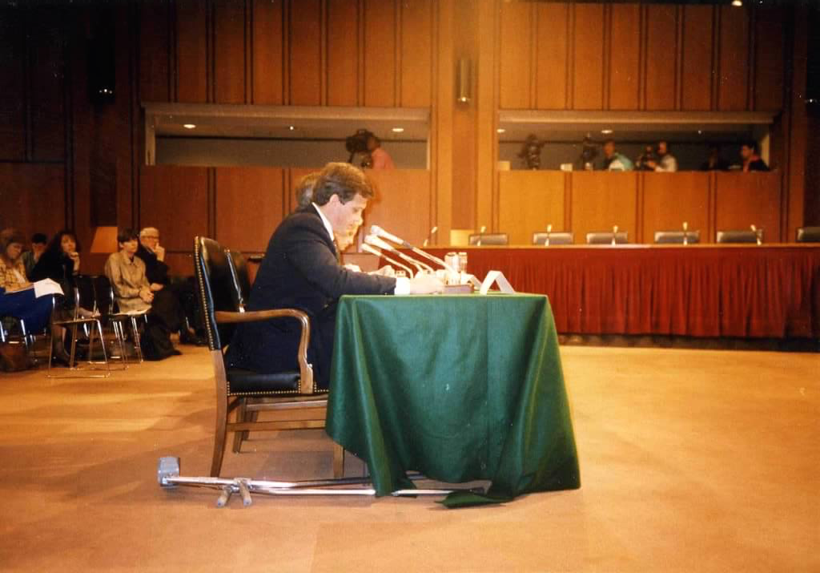
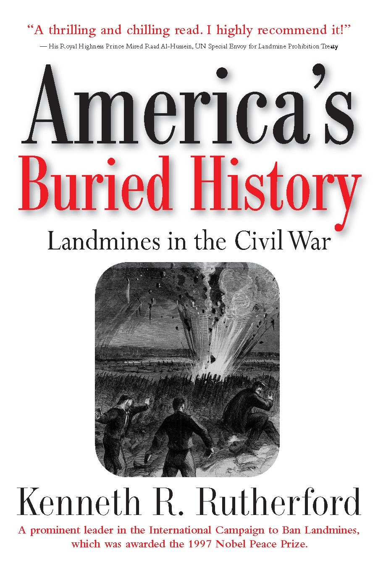
U.S. Senate and CNN
Competitive Stamina – Life comes down to 6-7 moments, and you need to make the plays. Seize the moment that opportunity.

Slide 5
ACT
Be hungry. You got to know that you have greatness within you. Being hungry makes a better hunter.
“Those who lack the courage will always find a philosophy to justify it.”
– Albert Camus [1957 Nobel Prize in Literature].
“Twenty years from now, you will be more disappointed by the things you didn’t do than by the ones you do.”
- Mark Twain

Slide 6
In Sum:
FEELINGS WITHOUT ACTION ARE MEANINGLESS
If you got a calling for anything, you are extremely lucky. And you should follow it, what may.
Don’t underestimate your feelings. God put that dream in your heart for a reason.
“We are not afraid of dying so much as of not having lived.’
– Leo Tolstoy [one of the greatest authors of all time].

Slide 7
POWER OF GRATITUDE
Seeds of bitternees can’t take place in a grateful heart.
We are not hard wired to be grateful. Protective DNA – to count curses instead of blessings. That’s part of evolution forcing people to focus on threats that could lead to our extinction.
Studies show that people can deliberately cultivate gratitude.
Think of things you have to be grateful for.
Challenge negative thoughts, asking yourself if they are true. Reframe them in a way that is more positive and helpful.

Slide 8
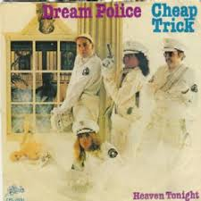
Give Your Dreams Life.
“I wish I’d had the courage to live a life true to myself, not the life others expected of me.” - #1 Regret of the Dying (From a Hospice Nurse)
“The dream police
They come to me in my bed
The dream police
They're coming to arrest me, oh no.”

Slide 9
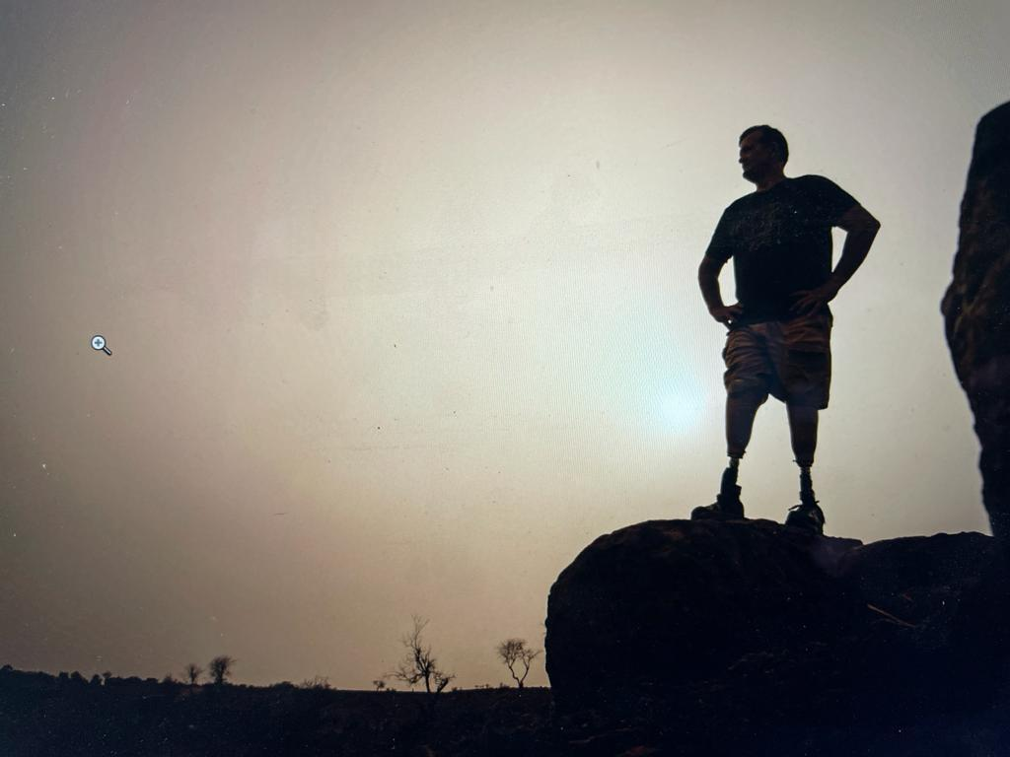
POWER OF GRATITUDE
FEELINGS WITHOUT ACTION ARE MEANINGLESS
CLEAR OUT THE NOISE
BE PHENOMENAL
ACT

Slide 10

THANK YOU
YO ALLAH ROKKU MAA JAM YEESO MAA
E
YO ALLAH ROKKU MAA JAM CAGGAL MAA
I believe I was kept on earth for a reason. And I just shared it with you.
Notes:
rah-mat
tasha-koor

